Slide 1
Quality of Place: Addressing The Needs of Otsego County
Solutions for today’s issues. Strategies for future growth.
July 12, 2023

Slide 2
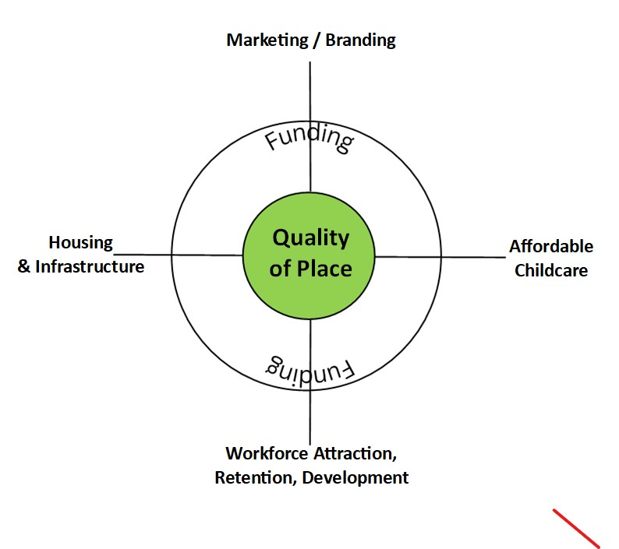
Our Mission
What is Leadership Otsego 2023?
Who We Are
Quality of Place
Areas of Focus
Workforce Development
Affordable Child Care
Housing and Infrastructure
Marketing/Branding
Funding
Why This is Important to Otsego County

Slide 3
Workforce Development, Attraction and Retention
Collaboration between Leaders
Highlight current programs
Education
Education repayment
Attracting
Training
Re-training

Slide 4
Workforce Attraction
Get the word out about the opportunities locally
Create a culture in the county that people want to be part of
Promote a work-life balance while offering professional and personal development
Provide training and upskilling opportunities during work hours
Openly share employer benefits that people seek
Develop benefits that people seek
Childcare
Competitive base salaries or hourly wages
Investing in Infrastructure, broadband, electrical, roads

Slide 5
Workforce Development
Training People
Leaders in business and government partner with Educational leaders to identify and build programs that are valuable and desired in our area.
Students- college programs, trade and technical skills programs
Re-training current workforce while being mindful of work life balance.
Develop meaningful internships that offer College Credits
Job placement with potential for loan reimbursement
Soft-skills and/or job readiness training covering topics like resume writing, job interviews, and time management
Develop on the job training or apprenticeship programs

Slide 6
Workforce Development
Identify programs and industries that are valuable and desired in the CNY/Upstate area:
Nursing
Education
Renewable Energy and Cleantech
Mechatronics
Homeland and Cyber Security
Bio-Tech and Life Sciences

Slide 7
Workforce Development
Educate Together
Course curriculum inline with local industry needs.
Local businesses should provide training and actively work with professors to provide up-to-date curriculum.
Offer seminars for local industry leaders on the things that attract applicants. Offer ideas, solutions and incentives that can be used to retain their new hires.
Local active and well-established intern programs with college credit.

Slide 8
Workforce Development
Identify Stakeholders
Needs a governing body/committee that consists of the following stakeholders:
Educational institutions
Local and state government officials
Local business owners/leaders
Regional Innovation Council
Sidney School District/SUNY Oneonta Teacher Pipeline
Hartwick's New Institute of Public Service

Slide 9
Workforce Retention
Education, Business, and Government leadership development
Path to education loan reimbursement.
Clear paths for advancement and continued development
Provide childcare services for employees
Encourage and promote a work-life balance
Recognize and reward your employees for their work
Create a culture that employees want to be part of
Build employee engagement
Use a variety of funding sources, such as grants, loans, and public-private partnerships, to support program sustainability.

Slide 10
Workforce Development, Attraction and Retention
And now…

Slide 11
Workforce Development, Attraction and Retention
Tuition Support
Reduced tuition/matched state tuition for local high school students in the local 8 counties.
Requires a commitment to stay in the contiguous 8 counties upon graduation
HartLand Promise tuition support

Slide 12
Workforce Development, Attraction and Retention
Student Loan Reimbursement
Upon graduation any student that receives a job in one of these established industries in the CNY region can work within the industry for 10 years and receive loan reimbursement.
Consult with those that employ grads to find out how their students are performing and proactively adjust programming to adjust to changing needs
Perhaps there is also a component that any students benefiting from this program would be encouraged to give back in the form of participating in education and marketing.

Slide 13
Affordable Child Care

Slide 14
Affordable Child Care

Slide 15
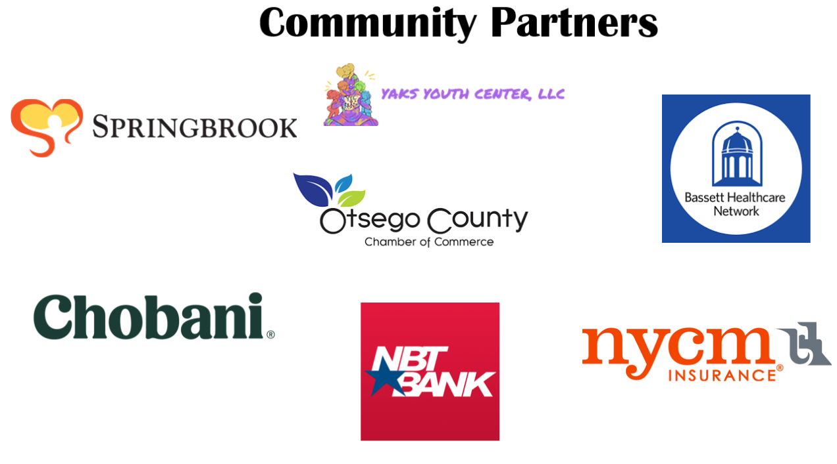
Affordable Child Care

Slide 16
Affordable Child Care
Quality of Place

Slide 17
Housing & Infrastructure

Slide 18
Housing & Infrastructure
This is how water and sewer utilities are currently configured.

Slide 19
Housing & Infrastructure
Incentivize electric/cable/fiber optic companies to install the cables as an investment in future customers.

Slide 20
Housing & Infrastructure
Benefits - If you build it, they will come!
WISE removes a major cost deterrent for prospective commercial development and home construction.
Developers will be more attracted to WISE areas because individual buyers won’t have the burden of building their own infrastructure.
The project itself provides employment opportunities.
This is an investment in our future!
Overall, it is an investment for the entirety of Otsego County

Slide 21
Housing & Infrastructure
Let’s Keep Digging!
Zoning departments
Planning commissions
City Halls
County board representatives
County Planning Board
Currently a study is being done on water/sewer within the county

Slide 22
Housing & Infrastructure
Funding
The burden of the investment doesn’t have to entirely sit on the taxpayers.
In 2014 for the Town of Cobleskill’s $9 mil water/sewer project only $500,000 came directly out of the town budget after loans and grants. That’s only 18% of the overall cost. A private investor also gave $100,000 per year for the first 20 years.
NYS and Governor Hochul want an increase in housing. There are billions of dollars allocated for this in grants.
It will save time and energy to write and apply for grants from the county rather than from several individual municipalities.

Slide 23
Housing & Infrastructure
This will be a major investment. With all the grants available, it will be cheaper and easier than dealing with these issues as individual municipalities. Everyone needs to work together to benefit the whole of Otsego County.
Increasing and sustaining the population and quality of life in ANY area of the county will benefit EVERY area of the county.
The WISE program helps establish a better quality of place - making that imagined scenario of your perfect employee a reality.

Slide 24
Otsego County Marketing Leadership

Slide 25
Marketing & Branding: Purpose
Otsego County is a vibrant place with endless opportunities. In order to fully harness these opportunities, proper branding and marketing must be in place.
Many business owners, new and current, struggle with marketing and branding.
Marketing is not just for retail. Proper marketing techniques can enhance the understanding of quality of place in our county.
Tourism
Effective employer branding and marketing to attract potential new employees through communication of benefit packages and perks
Deliver the message to investors, developers and area decision makers about growth opportunities in our county.
Our point and purpose is to deliver a complimentary educational module so business owners and employers are well positioned to thrive in this ever changing economy.

Slide 26
Exhibit A: Flyers on Trial

Slide 27
What’s wrong with this picture?

Slide 28
Marketing Principles for Otsego County
Marketing is the tide that raises all ships.
Many times we see marketing efforts fall flat. Efforts are in silos, and commonality and collaboration amongst communities and entities is not present.
Effective marketing can be a catalyst to drive change, encourage working together, and to stimulate the local economy.

Slide 29
Modules In the Learning Process
Basics
Who, What, When, Where, Why and How
Strategy
Effectiveness, Budget, Target Market, Appeal, Location/Radius and Human Component
Implementation
Social Media, Print Marketing, Flyers, Websites, Misc.
Execution
Can be hosted by community organizations, including OCC.
Think of marketing as telling your story while getting others interested in what it entails.

Slide 30
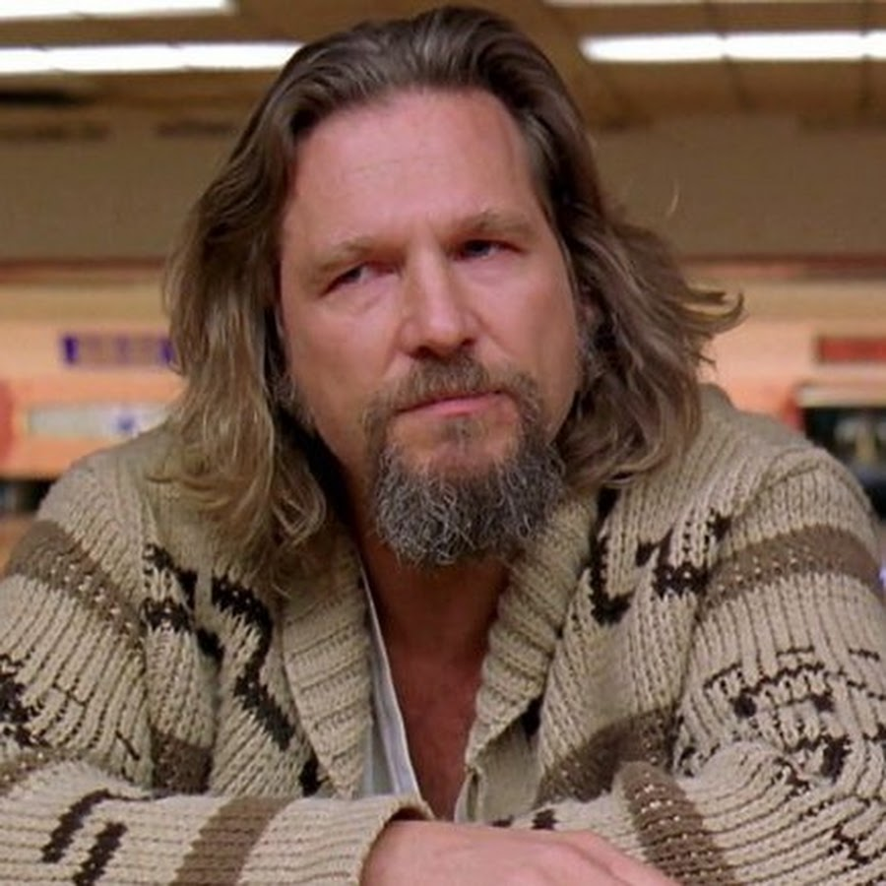
The rug that really ties the room together…
Proper marketing is the linchpin of overall economic development. The trickle down effects of proper marketing will drive the forces behind workforce development and retention, push assets towards housing, tackle the funding debacle when it comes to childcare, and benefit infrastructure improvements. It will also present Otsego county as a prime place to visit and settle.
Having available marketing courses throughout the county benefits all. From the freshman start up to the legacy farm, marketing is a primary driver. When people are properly educated on the topic, it will push economic activities for years to come, improving quality of place.

Slide 31
Funding
Funding
Marketing /
Branding
Marketing / Branding
Affordable Childcare
Quality of Place
Workforce
Housing Infrastructure

Slide 32
Funding
Regional Economic Development Council (REDC)
CFA- Consolidated Funding Application
https://apps.cio.ny.gov/apps/cfa
Empire State Development
Innovation Development Support
https://esd.ny.gov/global-ny-fund-grant-program

Slide 33
Funding
Marketing / Branding
Market New York
https://esd.ny.gov/market-new-york-tourism-grant-program
Funding opportunities for small business and new opportunities
Special Events
Workforce
Preparing New York’s Workforce for Jobs of the Future
https://workforcedevelopment.ny.gov/
Funding Opportunities
https://dol.ny.gov/funding-opportunities
WORKFORCE DEVELOPMENT CAPITAL GRANT PROGRAM
https://esd.ny.gov/workforce-development-capital-grant-program

Slide 34
Funding
Affordable Childcare
Child Care Assistance Programs
https://ocfs.ny.gov/programs/childcare/ccap
Child Care Grant Programs
https://ocfs.ny.gov/programs/childcare/grants
Child Care Stabilization Grant
Invest in NY – Child Care Deserts Grants
Grant for Retroactive Absences
Essential Worker Scholarship
Prior Funding Opportunities
Housing / Infrastructure
NYSERDA – Housing Initiative for New Construction
https://www.nyserda.ny.gov
Future Housing Initiative Programs
EmPower New York
NY Energy Advisor
Regional Clean Energy Hubs
New York State Home Program – Housing Trust Fund Corporation (HTFC)
Community Housing Development Organization (CHDO)
https://hcr.ny.gov/nys-home-program

Slide 36
SUMMARY
It is time for us to change for the betterment of our residents. We know this is a lot of information, but these are all areas that need to be looked at to create a better quality of place in Otsego County.
We are surviving on a day to day basis. If we do not start improving the place that people decide to call home, then we will not be thriving. It will instead be surviving.
If we can work together and begin the improvements with our workforce, our infrastructure, and our childcare, we can start to thrive and become a leading county in New York State.
Quality of Place
A sense of belonging,
Promoting community engagement
Attracting investment and talent, and ultimately enhancing the overall experience of living in our County
Through prioritizing and investing in the creation and maintenance of high-quality places, communities can create vibrant and sustainable environments that thrive and evolve with the changing needs and aspirations for our residents.

Slide 37
Summary
Otsego County’s leading revenue generator is tourism. We make sure our tourists are having a good time, but we also want to focus on the people that create our areas; our residents. Help us create Otsego County as a place where those tourists will want to come back to. And not just to visit, but to stay, put down roots and build their lives.

Slide 38
We thank you for your time and attention.

Slide 39
Thank You and Congratulations to the Leadership Otsego Class of 2023!
Ryan Bissinger – RJ Millworkers, Inc.
Patrick Bullock, Otsego Electric Cooperative, Inc,
Stephanie Byrnes – NYCM Insurance
Adam Clouse – The ARC Otsego
Tim Dauchy- NYCM Insurance
Gina Gardner- The Otesaga Hotel
Helen Garvin- LEAF, Inc.
Jessica Granish- Springbrook
James Johnson- Cleinman Performance Partners, Inc.
Chris Kegelman- NBT Bank
Paul Lawrence- Springbrook
Lara Leonard- The Morgan Stanley
Amber Merchant- Community, Bank N.A.
Gordon Mumbolo, Springbrook
Michelle Myers- Springbrook
Tara Nolet, ONC BOCES
Julianne Pettine, NYCM Insurance
Dominique Rockwell- Springbrook
Heather Schermerhorn- NYCM Insurance
Nathaniel Shuart- Destination Marketing Corp.
Tracy Smith-Reed- Yak’s Youth Center
Josh Taylor
Jennifer Teserio- Paperkite
Marisa VanWormer- Paperkite
Holly Webb- NYCM Insurance
Serina Wilber- NYCM Insurance

