Slide 1
Otsego County Energy Taskforce
Online Energy Survey of County Businesses
September 9th, 2020
Hosted by:

Slide 2
About the Otsego County Energy Taskforce (OCET)
Organized in 2019
Goal is to balance environmental sustainability, needs of businesses, and wellbeing of citizens with an Energy Roadmap completed in 2021
There is an Executive Committee and four stakeholder Subcommittees
Energy Supply and Distribution
Environment
Buildings and Efficiency
Economic Development
The Economic Development Subcommittee developed the survey of businesses being presented today
-- Representative Michele Farwell
Otego County Board of Representatives

Slide 3
Why feedback from businesses is important
New York State passed the Climate Leadership and Community Protection Act (CLCPA) in 2019
The CLCPA stipulates that 70% of our electricity in carbon free by 2030 and 100% by 2040 (presently the State is 5% wind and solar, 30% hydro and 25% nuclear)
Assessing our present and future County needs in the shadow of the CLCPA is critical in ensuring that Otsego has adequate energy resources to grow our economy
Improving building energy efficiency and transitioning to more efficient heating and cooling technologies is a big part of meeting these future targets
Value Proposition – As we learn more about your energy sources and needs, we can connect you with resources and upgrades that will save you money
-- Wayne Mellor
Member, OCET Economic Development Subcommittee

Slide 4
Taking the Survey
Jim Yienger
Principal
Climate Action Associates LLC

Slide 5
Your Opinion Counts. It helps OCET and County:
Understand how important are energy issues to your success compared with many other factors
Prioritize investments and programs to help business succeed in New York’s changing energy landscape
Engage NYSERDA, utilities, and others to fund energy projects, and to create incentives to overcome barriers.
Provide input to the state to guide energy policy
Take the survey HERE →
https://www.surveymonkey.com/r/73GDGK2

Slide 6
Energy Issues OCET is seeking feedback on
Energy supply and reliability
Do you have cost effective and reliable electricity, natural gas, fuel oil, and propane?
Are energy costs an obvious pain point for your business, or not so significant
Does the utility supply adequate electricity and/or natural gas? And for the next 5-10 years?
Renewable energy – an opportunity or concern?
As the state deprioritizes natural gas expansion, will this impact you and how can we over come it?
Are large scale solar farms and wind developments an opportunity for business and landowners?
Energy efficiency and new technologies
Are you aware of new efficiency and technology options available?
Are you aware of financial resources available to you?
Take the survey HERE →
https://www.surveymonkey.com/r/73GDGK2

Slide 7
Business Engagement – Online Survey
Over 1600 business entities in the county
Goal – minimum of 200-300 responses.
Please share the survey – get it out there
Confidentiality Pledge
No results are shared, sold, or provided to third parties
Survey is for public purpose to inform county roadmap
Only aggregated information will be presented – no businesses named or called out
Take the survey HERE →
https://www.surveymonkey.com/r/73GDGK2

Slide 8
How it Works – Quick and Easy
Takes 10-30 minutes – Take it right now during webinar
Who takes it? Business owner/executive, with support of finance and the facilities manager
38 Questions
Step 1 – About your business
Step 2 – About your Energy Profile
Step 3 – Energy Policy / County Plan
Step 4 – Future Energy Needs [Facilities Manager]
Step 5 – Your Energy Spend [Finance Dept] - Optional
Take the survey HERE →
https://www.surveymonkey.com/r/73GDGK2

Slide 9
Tips and Suggestions
Ask questions – get help. Contact the Support Team.
Be prepared – have information on your energy usage available if possible
Come back later if you don’t finish – survey results are saved in your browser
Don’t get hung up. Precision is great, but estimates are fine
Please try to complete the entire survey!!
Take the survey HERE →
https://www.surveymonkey.com/r/73GDGK2

Slide 10
Your Energy Spending

Slide 11
Energy Options – Question 31

Slide 12
Wildcard Question
Tells us more… opinions, facts, needs, or observations.

Slide 13
Survey Reward – Learn about Financial Incentives for Business

Slide 14
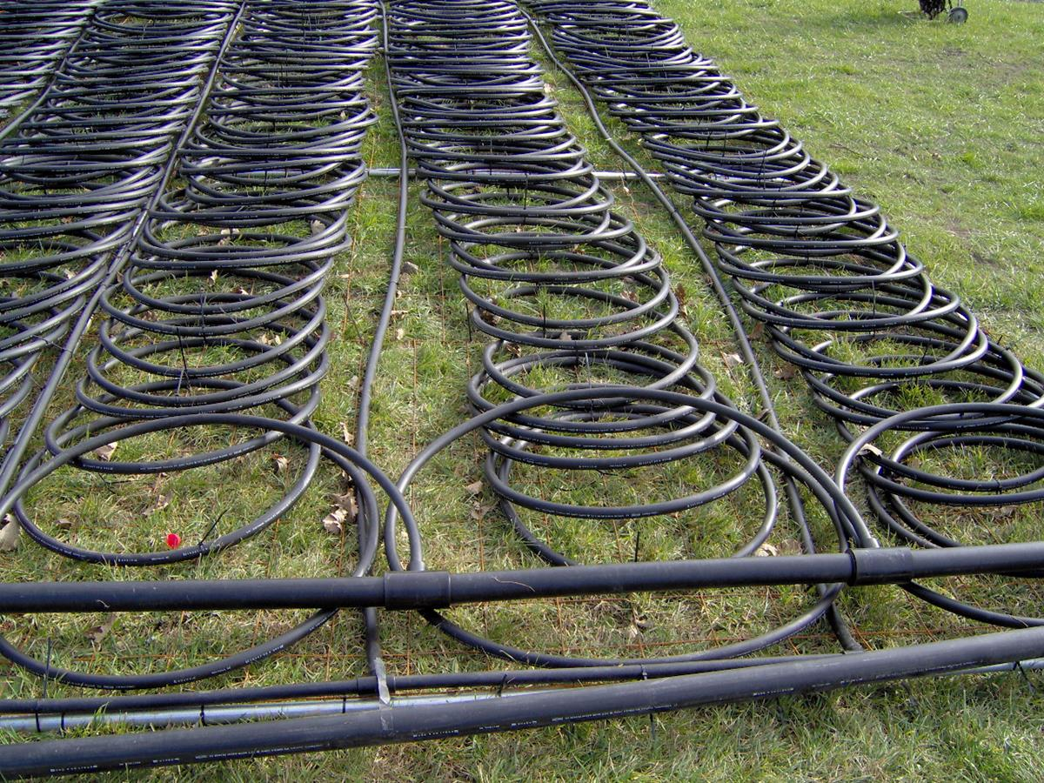
Businesses: Pivot Forward
NYSERDA Programs to help businesses save money through efficiency and renewables.
Bennett Sandler, Campaign Director
Heat Smart Mohawk Valley
Otsego County Energy Taskforce

Slide 15
NYSERDA Energy Study Programs
Flexible Technical Assistance (FlexTech) Free*
Commercial, Industrial, and Multifamily
Green Jobs Green NY Energy Study Free*
Businesses less than 100 employees
Not-for-profits of any size
Agricultural Energy Study Free
P-12 Green and Clean Energy Solutions Program Free/75%
REV Campus Challenge (Colleges & Universities) 60% Cost Share
*Until December 31, 2020

Slide 16
NYSERDA Energy Studies focus on
Building envelope upgrades
HVAC upgrades including heat pumps & HRV
Energy master planning
Retro commissioning (Advanced Controls)
Industrial and process efficiency
Carbon mitigation studies
Data center efficiency
Energy storage studies

Slide 17
Energy Saving Incentives
Utility Rebates for Heat Pumps
Solar: Rebates, Tax Credits, Accelerated Depreciation, Property Tax Exemption
Real Time Energy Management Program (30% Cost Share)
On-Site Energy Manager Program (75% Cost Share)
NYSERDA Loans
Commercial PACE financing
PAY FOR UPGRADES USING ENERGY SAVINGS!

Slide 18
Ground Source Heat Pump System 709 River Road, Milford, NY
Four commercial spaces: Revolution Solar (office), Red Shed Brewery Taproom (retail), Otsego Rural Housing Assist. (office), Richardson Window Works (Manuf.)
All electric building
$521 total bill for the month of December 2018

Slide 19
Air Source Heat Pump System Springfield, NY
Air source heat pumps are
54% cheaper to operate than propane

Slide 20
Air Source Heat Pump System Cooperstown, NY

Slide 21
Ground Source Heat Pump System Sidney, NY

Slide 22
Let us help you navigate options for energy studies and upgrades.
We can help you identify engineers and contractors familiar with your commercial sector profile.
We can help find incentives and financing to manage costs.
We can connect you with others who have gone through the process.
On Question 24, check the box “Learn more about incentives…’
Add your contact info in Question 25 or
Signup online, by email, or by phone
Heatsmartmv.org, bsandler@heatsmartmv.org, (607) 435-1364

Slide 23
THANK YOU / Q&A
Survey Support
Jim Yienger (mr_jjy@climatetools.com / 518-560-9830)
Nik Moran (nik.moran@climatetools.com)
Energy Programs and Funding
Bennet Sandler (bsandler@heatsmartmv.org)
OCET Speaker Contact Information
Rep. Michele Farwell (farwellm@otsegocounty.com)
Wayne Mellow (wmellor@stny.rr.com)
Take the survey HERE →
https://www.surveymonkey.com/r/73GDGK2

